Slide 1
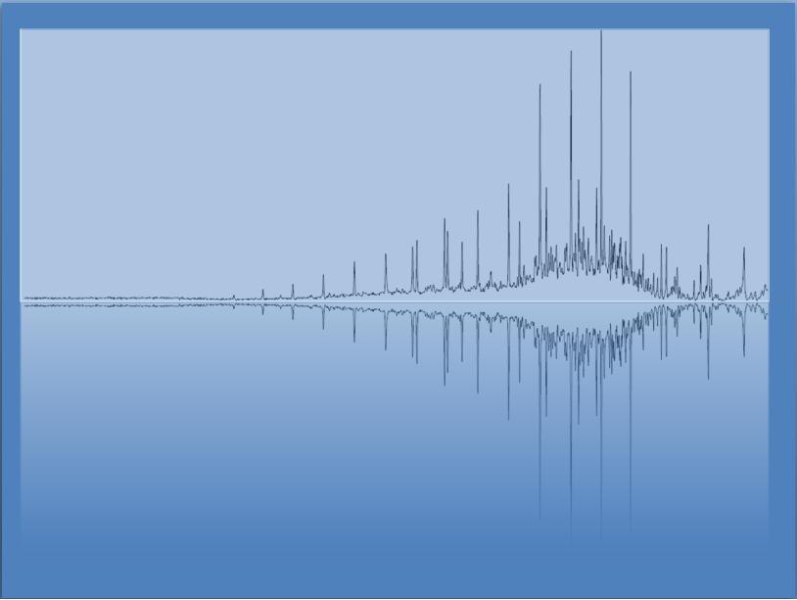
Reaction Stoichiometry
Chem 3A- Yates

Slide 2
Outline
What is Stoichiometry?
Solid Phase Stoichiometry
Basic mass-to-mass conversions
Limiting/excess reactants
Theoretical yield
% yield
Solution Phase Stoichiometry
Gaseous Phase Stoichiometry
Reaction Heat Stoichiometry

Slide 3
Reaction Stoichiometry
The coefficients specify the relative amounts of each of the substances in the reaction.
2 C₈H₁₈(l) + 25 O₂(g) → 16 CO₂(g) + 18 H₂O(g)
2 molecules of C₈H₁₈ react with 25 molecules of O₂
to form 16 molecules of CO₂ and 18 molecules of H₂O
or
2 mol C₈H₁₈ : 25 mol O₂ : 16 mol CO₂ : 18 mol H₂O

Slide 4
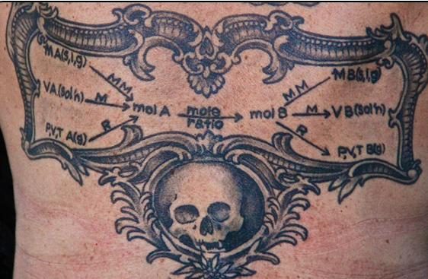
Stoichiometry Tattoo
Randa Roland, Lecturer at U.C. Santa Cruz, taken from C&E News, Volume 93 Issue 3 | p. 30

Slide 5
Outline
What is Stoichiometry?
Solid Phase Stoichiometry
Basic mass-to-mass conversions
Limiting/excess reactants
Theoretical yield
% yield
Solution Phase Stoichiometry
Gaseous Phase Stoichiometry
Reaction Heat Stoichiometry

Slide 6
Example: Estimate the mass of CO₂ produced in 2007 by the combustion of 3.5 x 10¹⁵ g gasoline
Assuming that gasoline is octane, C₈H₁₈, the equation for the reaction is
2 C₈H₁₈(l) + 25 O₂(g) → 16 CO₂(g) + 18 H₂O(g)
The equation for the reaction gives the mole relationship between amount of C₈H₁₈ and CO₂, but we need to know the mass relationship, so the conceptual plan will be
g C₈H₁₈
mol C₈H₁₈
mol CO₂
g CO₂

Slide 7
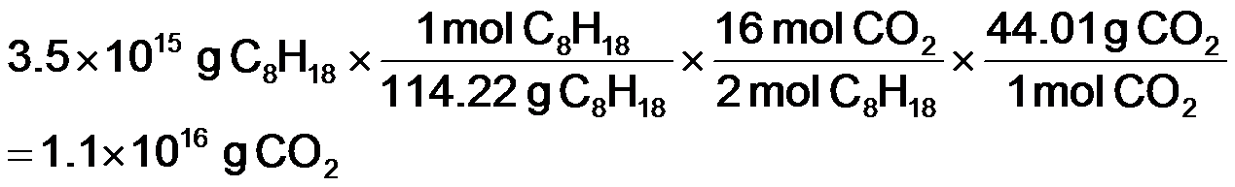
Example: Estimate the mass of CO₂ produced in 2007 by the combustion of 3.5 x 10¹⁵ g gasoline
Given:
Find:
3.4 x 10¹⁵ g C₈H₁₈
g CO₂
Conceptual Plan:
Relationships:
1 mol C₈H₁₈ = 114.22g, 1 mol CO₂ = 44.01g, 2 mol C₈H₁₈:16 mol CO₂
g C₈H₁₈
mol C₈H₁₈
mol CO₂
g CO₂
Solution:
Check:
because 8x moles of CO₂ as C₈H₁₈, but the molar mass of C₈H₁₈ is 3x CO₂, the number makes sense

Slide 8
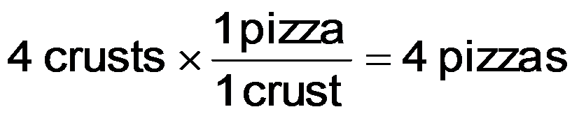
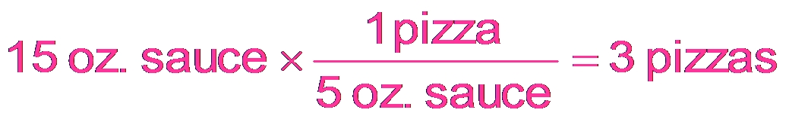
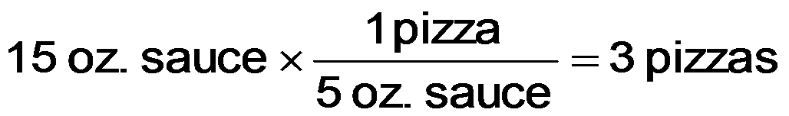
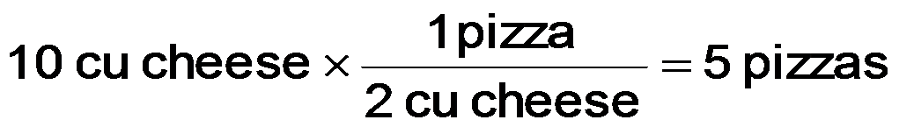
Making Pizzas (An analogy for limiting reactants, theoretical yield, and % yield)
-Given the following “equation” for making a pizza.
1 crust + 5 oz. tomato sauce + 2 cu cheese → 1 pizza
-How many could we make if we had 4 crusts,
15 oz. tomato sauce, and 10 cu cheese?

Slide 9
The Limiting Reactant
The reactant that limits the amount of product is called the limiting reactant
sometimes called the limiting reagent
the limiting reactant gets completely consumed
Reactants not completely consumed are called excess reactants
The amount of product that can be made from the limiting reactant is called the theoretical yield

Slide 10
Practice — How many moles of Si₃N₄ can be made from 1.20 moles of Si and 1.00 moles of N₂ in the reaction 3 Si + 2 N₂ → Si₃N₄?

Slide 11
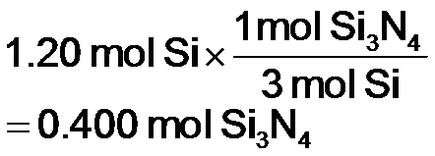
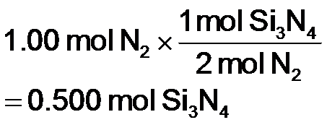
Practice — How many moles of Si₃N₄ can be made from 1.20 moles of Si and 1.00 moles of N₂ in the reaction 3 Si + 2 N₂ → Si₃N₄?
Given:
Find:
1.20 mol Si, 1.00 mol N₂
mol Si₃N₄
Conceptual Plan:
Relationships:
2 mol N₂ : 1 Si₃N₄; 3 mol Si : 1 Si₃N₄
mol Si
mol Si₃N₄
Pick least
amount
Limiting
reactant and
theoretical
yield
mol N₂
mol Si₃N₄
Solution:
Limiting
reactant
Theoretical
yield
Notes:
11

Slide 12
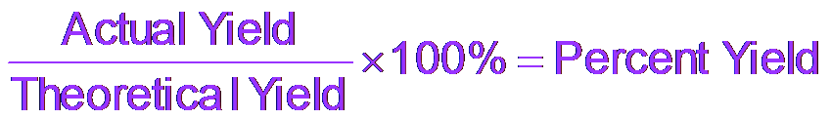
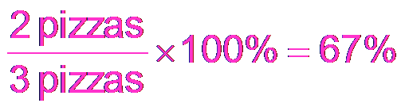
More Making Pizzas
Let’s now assume that as we are making pizzas, we burn a pizza, so that we only make two pizzas.
The actual amount of product made in a chemical reaction is called the actual yield.
We can calculate the percentage of the maximum number of pizzas we actually make.
In chemical reactions, we call this the percent yield.

Slide 13
Practice — How many grams of N₂(g) can be made from 9.05 g of NH₃ reacting with 45.2 g of CuO? 2 NH₃(g) + 3 CuO(s) → N₂(g) + 3 Cu(s) + 3 H₂O(l) If 4.61 g of N₂ are made, what is the percent yield?
Tro: Chemistry: A Molecular Approach, 2/e

Slide 14
Outline
What is Stoichiometry?
Solid Phase Stoichiometry
Basic mass-to-mass conversions
Limiting/excess reactants
Theoretical yield
% yield
Solution Phase Stoichiometry
Gaseous Phase Stoichiometry
Reaction Heat Stoichiometry

Slide 15
Solution Stoichiometry
Randa Roland, Lecturer at U.C. Santa Cruz, taken from C&E News, Volume 93 Issue 3 | p. 30

Slide 16
Solution Stoichiometry
Mole Ratio
Molarity
Molarity
V (Liters) of A
mole A
mole B
V (Liters) of B

Slide 17
How many Liters of 0.115 M KI Is Needed to React with 0.104 L of a 0.225 M Pb(NO₃)₂? 2 KI(aq) + Pb(NO₃)₂(aq)→ 2 KNO₃(aq) + PbI₂(s)

Slide 18
How many Liters of 0.115 M KI Is Needed to React with 0.104 L of a 0.225 M Pb(NO₃)₂? 2 KI(aq) + Pb(NO₃)₂(aq)→ 2 KNO₃(aq) + PbI₂(s)
Mole Ratio
Molarity
Molarity
V (Liters) of A
mole A
mole B
V (Liters) of B

Slide 19
How many Liters of 0.115 M KI Is Needed to React with 0.104 L of a 0.225 M Pb(NO₃)₂? 2 KI(aq) + Pb(NO₃)₂(aq)→ 2 KNO₃(aq) + PbI₂(s)
Mole Ratio
Molarity
Molarity
V (Liters) of A
mole A
mole B
V (Liters) of B
= 0.40696 L
= 0.407 L KI sol’n

Slide 20
Outline
What is Stoichiometry?
Solid Phase Stoichiometry
Basic mass-to-mass conversions
Limiting/excess reactants
Theoretical yield
% yield
Solution Phase Stoichiometry
Gaseous Phase Stoichiometry
Reaction Heat Stoichiometry

Slide 21
Gas-Phase Stoichiometry
Randa Roland, Lecturer at U.C. Santa Cruz, taken from C&E News, Volume 93 Issue 3 | p. 30

Slide 22
Gas-Phase Stoichiometry
P, V, T of Gas A
mole A
mole B
P, V, T of Gas B

Slide 23
Example 11.11:
How many liters of oxygen gas form when 294 g of KClO₃ completely reacts in the following reaction? Assume the oxygen gas is collected at STP.

Slide 24
Outline
What is Stoichiometry?
Solid Phase Stoichiometry
Basic mass-to-mass conversions
Limiting/excess reactants
Theoretical yield
% yield
Solution Phase Stoichiometry
Gaseous Phase Stoichiometry
Reaction Heat Stoichiometry

Slide 25
Heat Energy and Stoichiometry
The amount of energy change in a reaction depends on the amount of reactants.
You get twice as much heat out when you burn twice as much CH₄.
The amount of energy absorbed or released can be used as a stoichiometric quantity.
C₃H₈(l) + 5 O₂(g) → 3 CO₂(g) + 4 H₂O(g) ΔH_{rxn} = −2044 kJ
1 mol C₃H₈ : 5 mol O₂ : 3 mol CO₂ : 4 mol H₂O : −2044 kJ

Slide 26
Example—How Much Heat Is Associated with the Complete Combustion of 11.8 x 10³ g of C₃H₈(g)?
Given:
Find:
11.8 x 10³ g C₃H₈,
heat, kJ
Solution Map:
Relationships:
1 mol C₃H₈ = -2044 kJ, Molar mass = 44.11 g/mol
g C₃H₈
mol C₃H₈
kJ
Solution:
Check:
The sign is correct and the value is reasonable.

